Slide 1
Web Scraping & Salary Prediction
Factors that impact salary & distinguish job category

Slide 2



Data Source – Seek Website
Keywords:
Data Science
Data Scientist
Data Analytics
Data Analyst

Slide 3
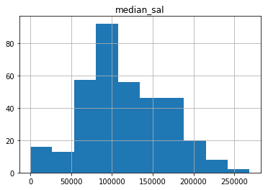
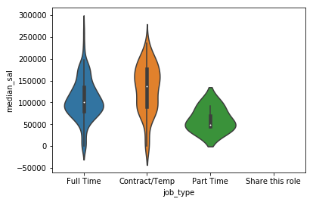
Data Collection & EDA
Web Scraping - Beautiful Soup
Median Salary - $107750.0

Slide 4
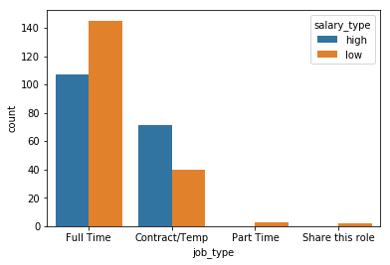
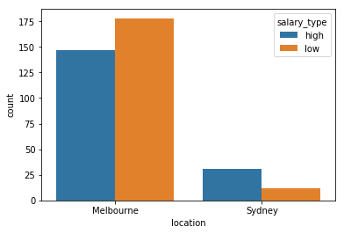
Salary Vs Job Type & Location

Slide 5
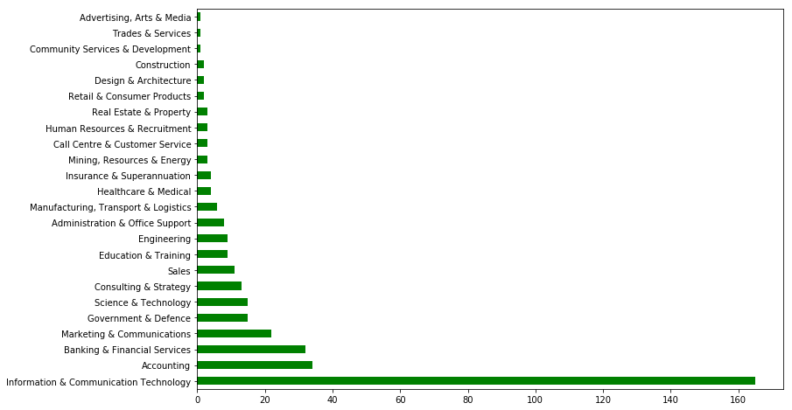
Prevalence of data jobs in different Category

Slide 6
NLP & Model Selection for Salary prediction
NLP - TFIDF
Best Model
Factors which impact the prediction of Salary:
Data
Experience
Skills
Team
Management
Role
MultinomialNB – Salary prediction
72.9% Accuracy
Best Model KNN – Job category
46.2% Accuracy

Slide 7
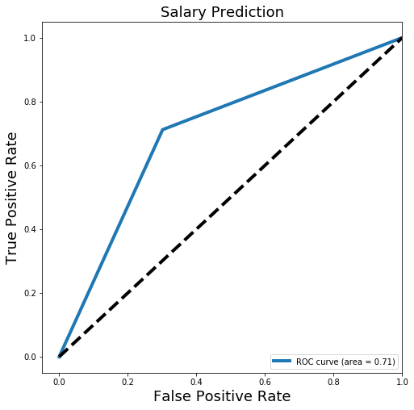
ROC Curve – Salary Prediction

Slide 8

Conclusion
By this model can predict salary with 72% confidence
Definitely Sydney provides high salary for the same level of skillset
Experience is the key indicator for a Senior or Junior job title

